Slide 1
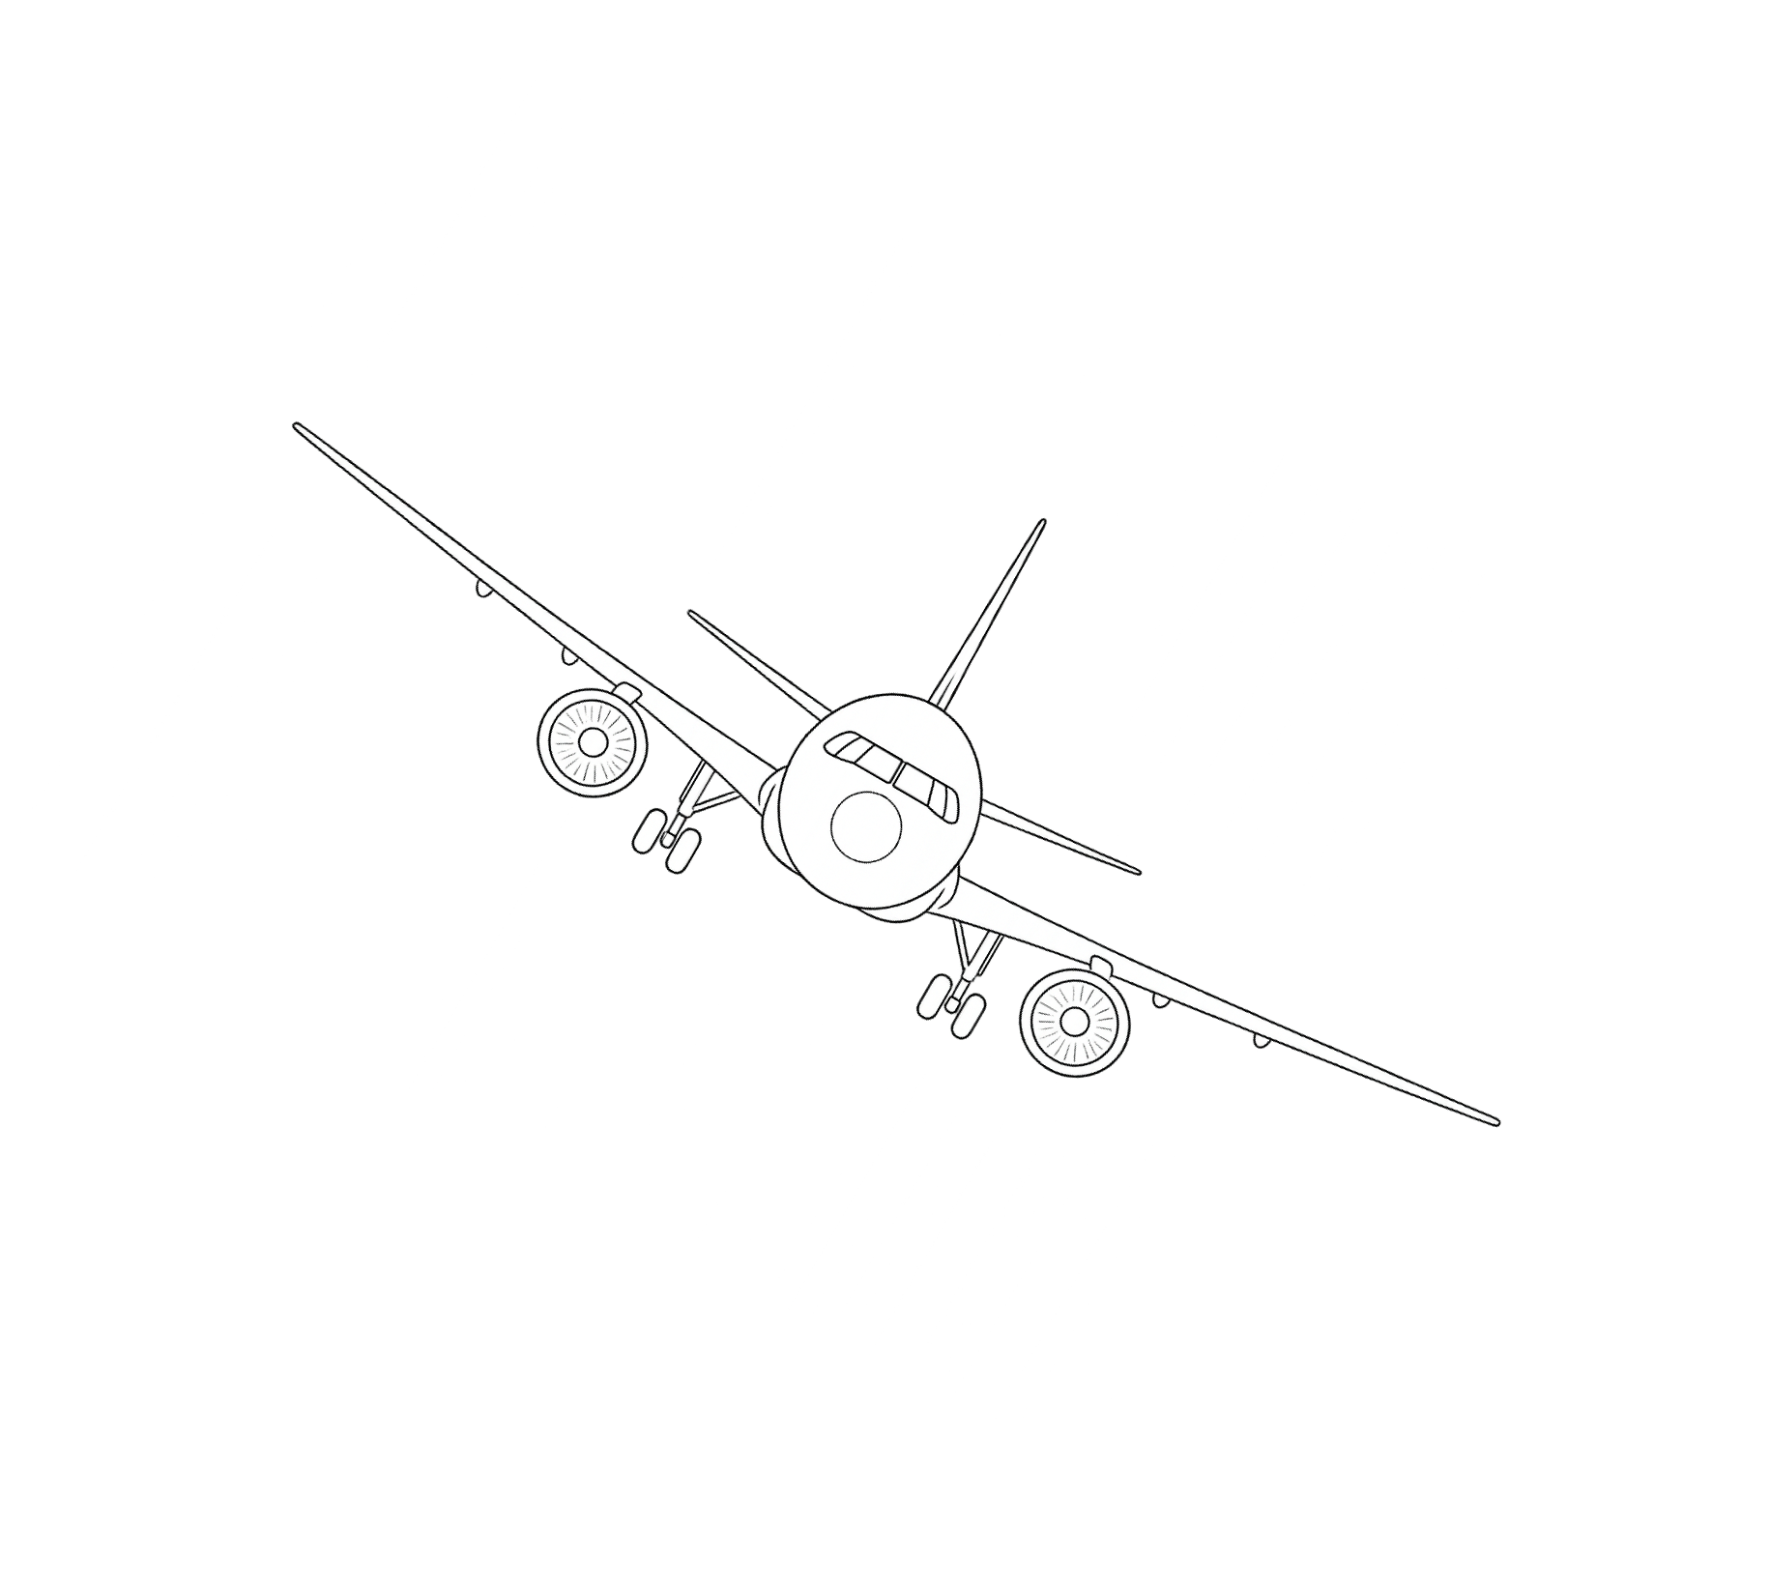
BUSINESS ANALYTICS CLUB
PREDICTING
LIKELIHOOD OF
PLANE CRASHES
INSIGHT TEAM
FALL 2025

Slide 2





BUSINESS ANALYTICS CLUB
BROUGHT TO
YOU BY
Daniel Liang
Prateek Nedungadi
Luca Chiappetta
Shachi Mahajan
Kevin Dong
INSIGHT TEAM
FALL 2025

Slide 3





BUSINESS ANALYTICS CLUB
BROUGHT TO
YOU BY
Kevin Dong
Shachi Mahajan
Luca Chiappetta
Daniel Liang
Prateek Nedungadi
INSIGHT TEAM
FALL 2025

Slide 4
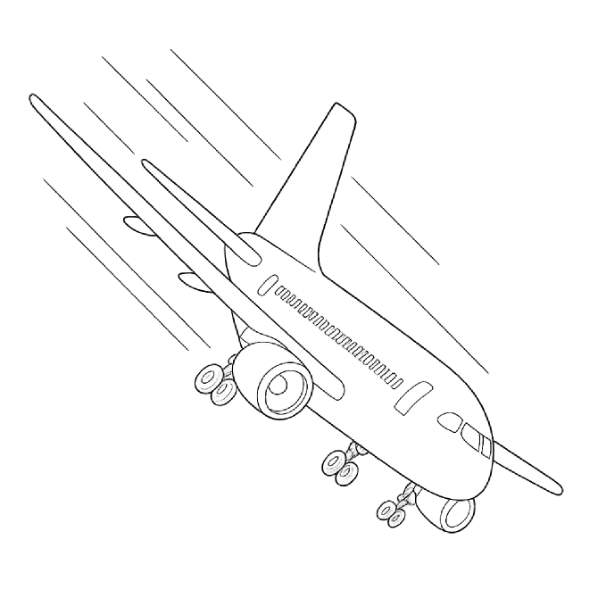

BUSINESS ANALYTICS CLUB
STARTING
QUESTION
THIS MODEL WOULD AIM TO PREDICT WHICH AIRPLANES ARE MORE LIKELY TO CRASH AND WHAT CONDITIONS MAKE AIRPLANE CRASHES PROBABLE. THIS WOULD ALLOW AIRLINES AND AIRPORTS TO DETERMINE WHERE THE PAIN POINTS ARE AND WORK ON POLICY TO DECREASE AIRPLANE CRASHES.
INSIGHT TEAM
FALL 2025

Slide 5
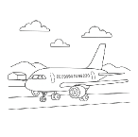

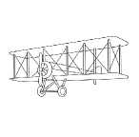
BUSINESS ANALYTICS CLUB
DATA OVERVIEW
DATA SET ONE
Airplane Crashes and Fatalities Since 1908
LINK TO FEATURE
All civil and commercial aviation accidents of scheduled and non-scheduled passenger airliners worldwide, which resulted in a fatality (including all U.S. Part 121 and Part 135 fatal accidents)
DATA SET TWO
LINK TO FEATURE
DATA SET THREE
LINK TO FEATURE
Airplane Crashes and Fatalities Since 1908 to Present 2021 (from plancrashinfo.com)
INSIGHT TEAM
FALL 2025

Slide 6


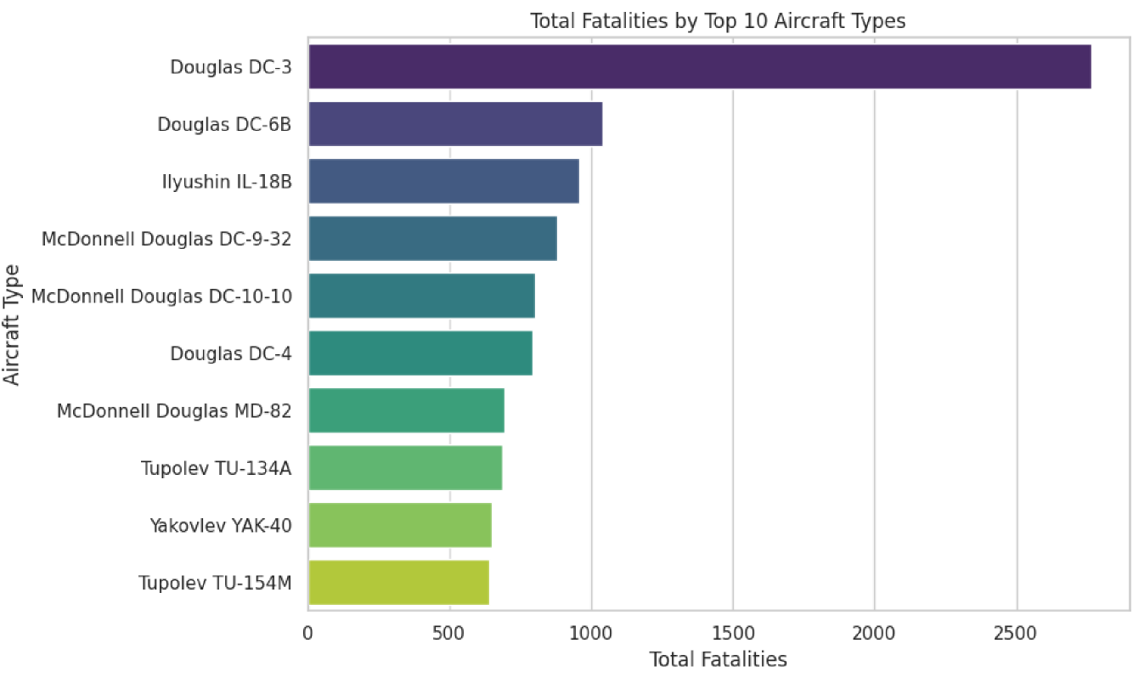
BUSINESS ANALYTICS CLUB
INSIGHT TEAM
FALL 2025

Slide 7
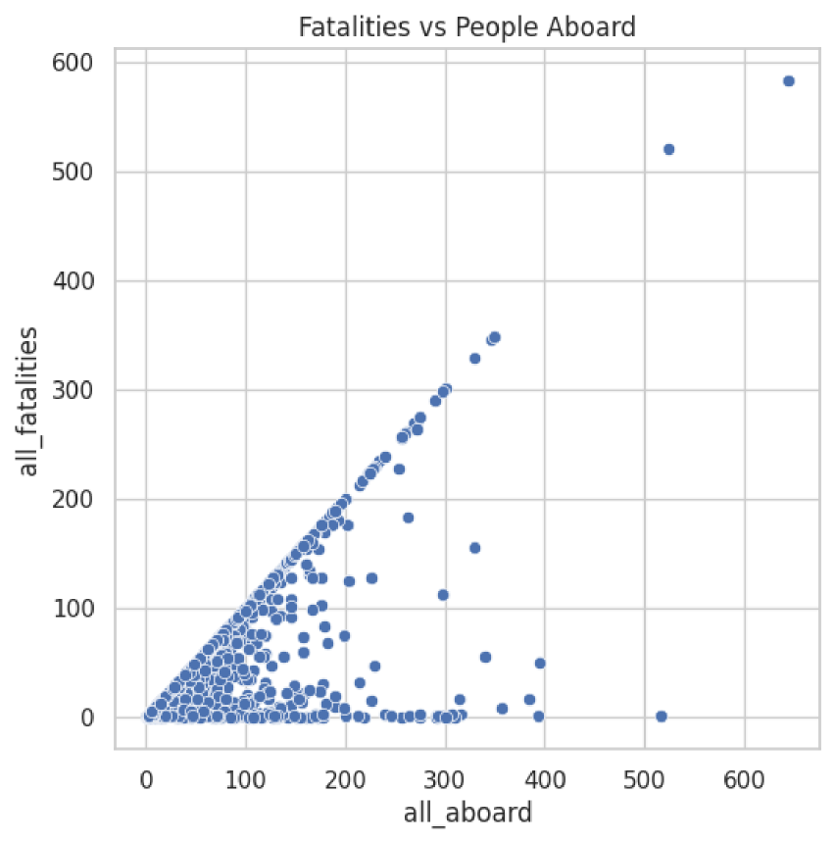
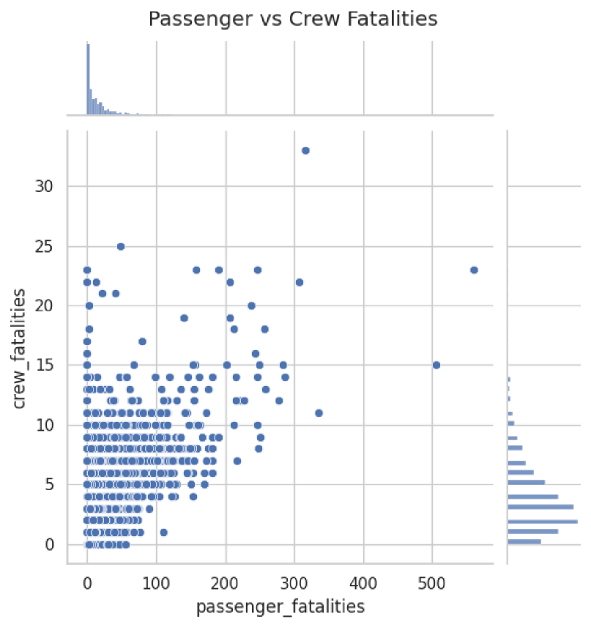
BUSINESS ANALYTICS CLUB
INSIGHT TEAM
FALL 2025

Slide 8

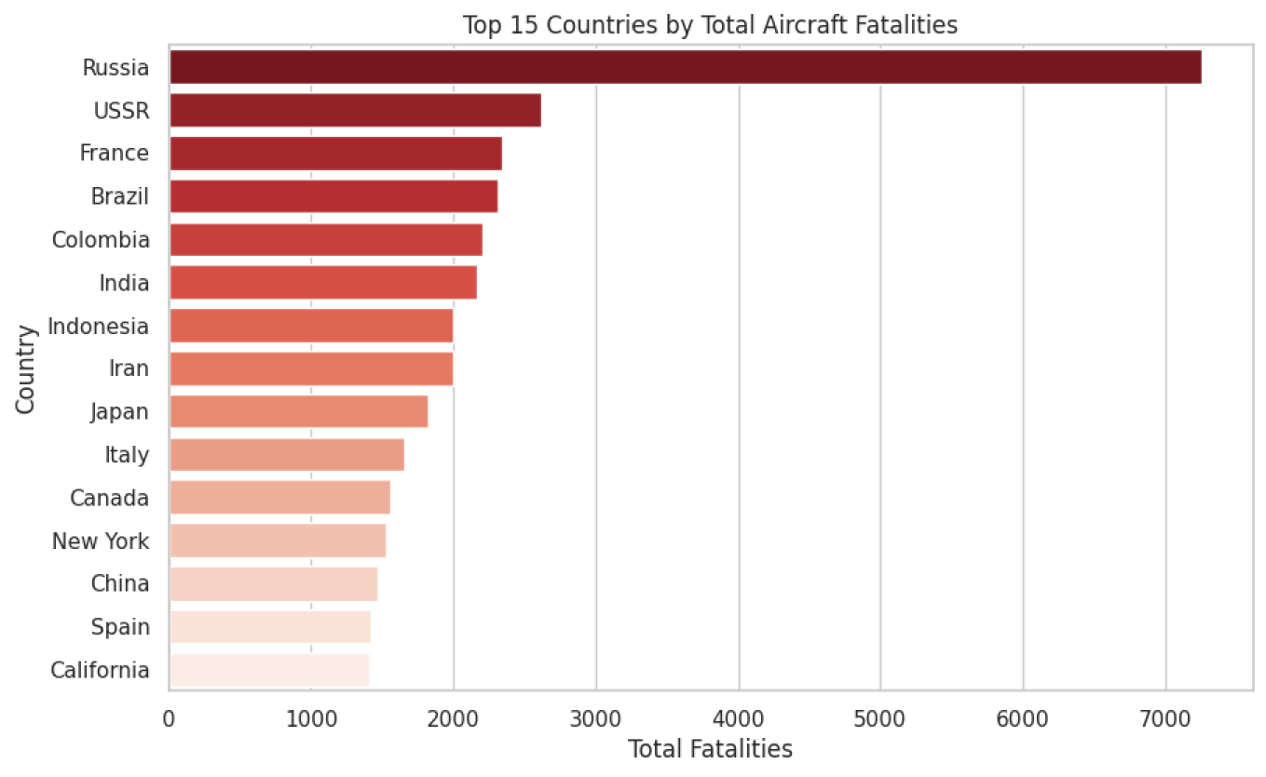
BUSINESS ANALYTICS CLUB
INSIGHT TEAM
FALL 2025

Slide 9
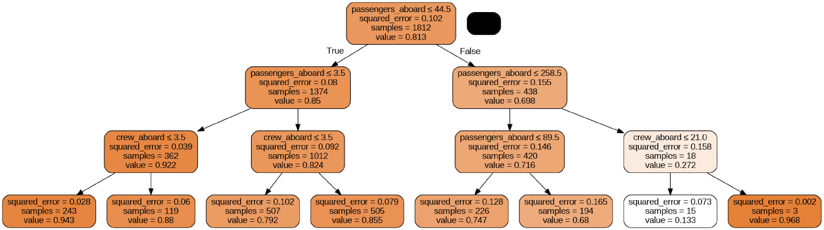
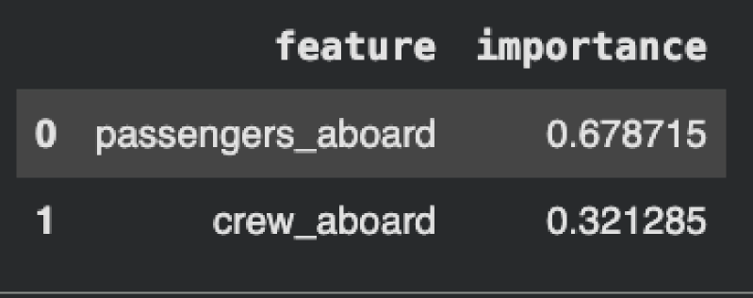
Decision Tree
Use passenger and crew data to predict overall crash fatality rates and reveal key patterns in aviation safety
Random Forest
n_estimators=390, max_features=2
RMSE: 0.3434188733910872

Slide 10
COMPANY NAME
Model Creation
INSIGHT TEAM

Slide 11
COMPANY NAME
LINEAR REGRESSION
TEAM NAME
FALL 2025

Slide 12


COMPANY NAME
WHAT’S AN IMPORTANT QUESTION YOU MIGHT WANT TO ASK THE USER?
TEAM NAME
TODAY’S DATE

Slide 13

COMPANY NAME
Easy to use
HOW DO YOU FEEL ABOUT THIS FEATURE?
Would use never
Would use daily
Difficult to use
TEAM NAME
TODAY’S DATE

